Slide 1
Mastering the Architecture Design Session (ADS)

Slide 2
Abstract and learning objectives
Abstract and learning objectives
Facilitate discussion around top ADS tips & tricks, leading to presentation on what makes a great ADS from requirements collection to architecture.

Slide 3
Basics
An Architecture Design Session (ADS) is a one- to multi-day engagement driven by technical sales that maps technical solutions to customer opportunities.

Slide 4
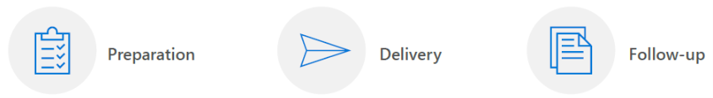
Requirements for success
To successfully lead an ADS, you will need significant time for planning prior to the engagement and for collaboration during the engagement.
In the session, you will identify the opportunity and current state, whiteboard and develop possible solutions for the future state, and propose an implementation plan.
Delivering an ADS is one effective way to land on a shared vision and scope.

Slide 5
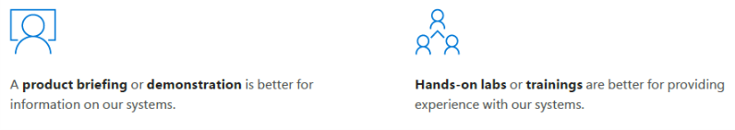
Preparation (1/3)
Initial meeting between the opportunity manager and technical sales (TSP or CSA).
Verify that the collaborative problem-solving approach of an ADS is the best engagement option.

Slide 6
Preparation (2/3)
Planning call with the customer, opportunity manager, and technical sales.
Identify key players for each section of the ADS and prepare a meeting agenda.
Opportunity goals, objectives, and scope
General outline of the existing system
Agenda
Location (not customer site if possible)
Verify that you have the appropriate guest list for the engagement.
Customer attendees (decision makers):
Sponsor, Business representative(s), Project manager
Technical representative(s) (depending on project: Advisors/partners, Architecture, Development, Infrastructure, Operations, Security)
Microsoft attendees
Architect (facilitates session), SMEs (depending on project), Account team

Slide 7
Preparation (3/3)
Develop possible solutions, an implementation plan, and a meeting agenda.
Design
Create a technical solution proposal based on reference architectures.
Plan
Create a phased implementation plan proposal that allows the customer to control cost and schedule impacts.
Participants
Identify key players for each section of the ADS and prepare a meeting agenda.

Slide 8
Delivery
Whiteboards and Surface Hub support the type of collaboration you’ll need for a successful ADS. Focus on your stakeholders, use the whiteboard as a tool for recording ideas, and get approval at each step before moving forward.

Slide 9
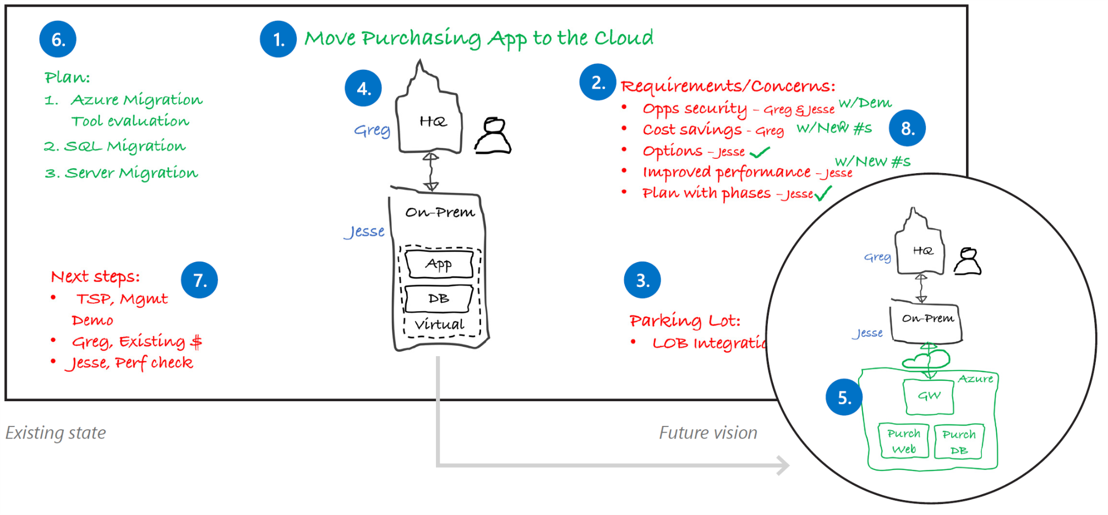
Best practice whiteboard layout
1. Project Goal | 2. Requirements & concerns | 3. Parking lot | 4. Current State | 5. Future Vision | 6. Implementation plan | 7. Next steps | 8. Wrap-up
Notes:
1. Project goal
Write down the project goal to help focus everyone to the desired outcomes.
2. Requirements and concerns
Begin with the items you’ve listed from the pre-call. Make sure that everyone gets a chance to be heard. Write down names next to each person’s requirements or concerns.
3. Parking lot
Acknowledge out-of-scope items. Help people set these concerns aside for later and focus back on the topic at hand.
4. Current state
Diagram the current state and ownership in black. The customer may help diagram this on the whiteboard. Be careful with technical depth. Focus on the system details that affect the ADS outcomes.
5. Future vision
Capture a high-level view of what the customer really wants in green before diving into technologies. Help customers envision the potential opportunities with Microsoft technologies.
6. Implementation plan
Break the plan into clear steps so the customer can track the project schedule and budget flexibility.
7. Next steps
Assign immediate action items during the meeting.
8. Wrap-up
Verify with all stakeholders that their requirements and concerns have been sufficiently addressed with the solution and plan. Close with agreement on the next steps.

Slide 10
Follow-up documentation
Email the meeting notes and a draft of the vision and scope to the ADS participants.
Include:
Photos of the board(s)
Key decisions made
Document the requirements and concerns, implementation plan, next steps and action items
A formal illustration of the current state and proposed solution in PowerPoint or Visio

Slide 11

What are your best practices?

